Slide 1

AI-Powered Medical Diagnosis System: A Streamlit-Based Solution
This presentation outlines a comprehensive AI-powered medical diagnosis system leveraging machine learning models and a user-friendly web application. We will explore the problem, the solution, and the project's roadmap.

Slide 2
The Problem: Inefficiencies in Traditional Diagnosis
Manual Assessments
Expert Availability
Traditional diagnosis often relies on manual assessments by healthcare professionals, which can be time-consuming, subjective, and prone to human error.
Access to specialized medical expertise can be limited in certain areas, leading to delays in diagnosis and potentially misdiagnosis.

Slide 3
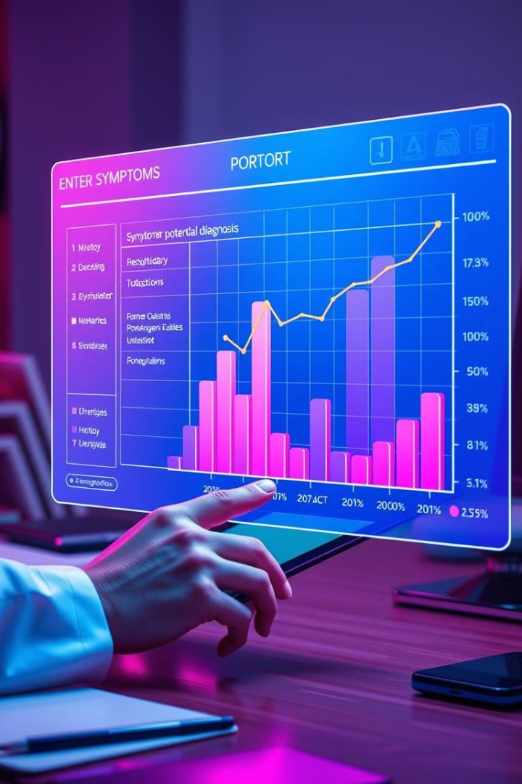
The Solution: AI-Driven Disease Prediction
1
Machine Learning Models
Our system utilizes various machine learning algorithms like Random Forest, SVM, and Logistic Regression to predict diseases based on patient symptoms.
2
Streamlit Web Application
A user-friendly Streamlit web application allows patients to input their symptoms, enabling real-time disease prediction.

Slide 4

Software Requirements: Building the System
Programming Language
Python 3.x is chosen for its extensive machine learning libraries and robust development capabilities.
Libraries
Essential libraries include TensorFlow/Keras for deep learning, Scikit-learn for machine learning, Pandas for data manipulation, NumPy for numerical operations, Matplotlib and Seaborn for data visualization, and OpenCV for image processing.
Frameworks
Streamlit provides a user-friendly interface for building interactive web applications, while Flask can be used for API-based deployment if needed.
Database
SQLite is used as a lightweight database for storing data if necessary. It provides a simple and efficient way to manage data for the system.

Slide 5
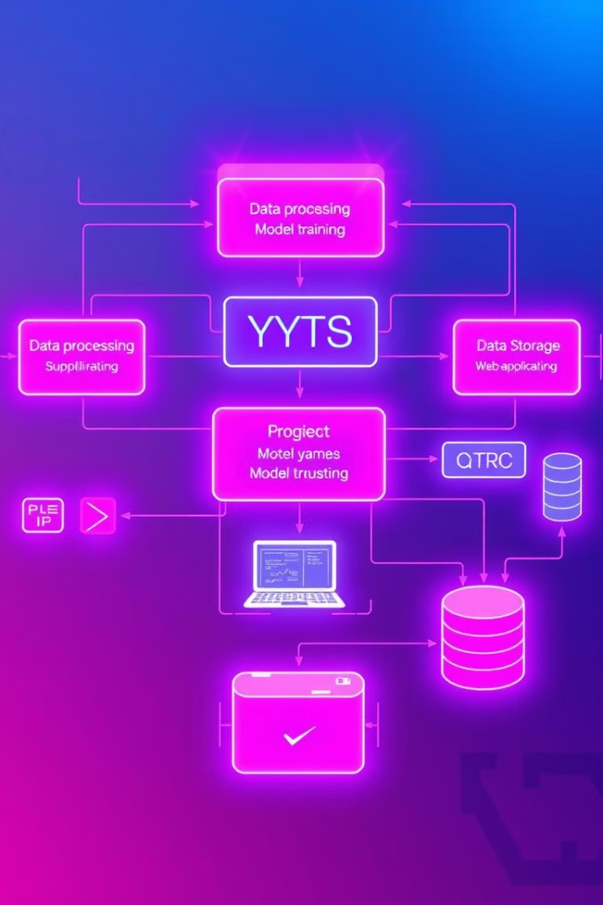




System Architecture: A Detailed Look
The system starts with data preprocessing, cleaning, transforming, and selecting relevant features for model training.
Machine learning models are trained on structured symptom-based datasets, ensuring accurate and reliable predictions.
The web application enables users to input their symptoms via the Streamlit UI, which triggers disease prediction by the ML model.
The system displays real-time results with probability scores, providing insightful information to healthcare professionals.

Slide 6
Project Plan: A Phased Approach
Phase 1
1
Focuses on data collection and preprocessing, ensuring a robust and accurate dataset for model training.
2
Phase 2
Involves model selection and training, optimizing model performance for accurate disease prediction.
Phase 3
3
Focuses on web application development, building a user-friendly interface for symptom input and result display.
4
Phase 4
Involves rigorous system testing and performance evaluation to ensure accuracy, reliability, and scalability.
Phase 5
5
Focuses on deployment to Streamlit Cloud for remote access and planning future enhancements for ongoing improvement.

Slide 7
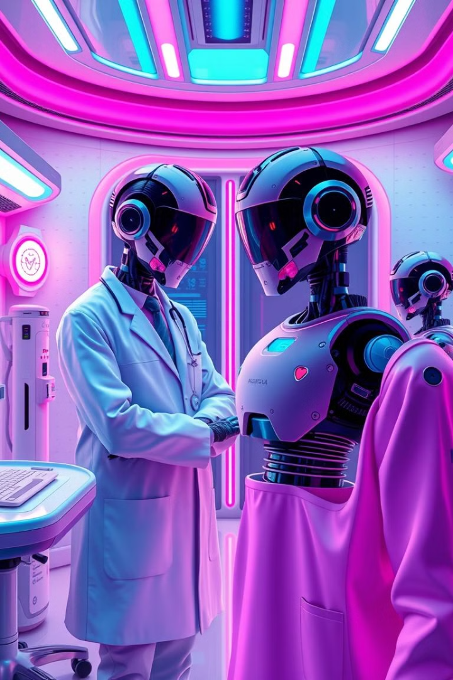




Future Scope: Expanding the System's Capabilities
Deep Learning Integration
Integrating deep learning models like CNN and LSTM will further enhance the accuracy and robustness of the prediction system.
Disease Expansion
Expanding the system's capabilities to cover a wider range of diseases, including rare conditions, will make it more comprehensive and valuable.
Real-time Monitoring
Integrating real-time health monitoring using wearable devices will enable continuous data collection and provide a more holistic view of patient health.
NLP Integration
Utilizing natural language processing (NLP) for symptom interpretation from text or audio inputs will enhance user experience and provide more accurate data.

Slide 8
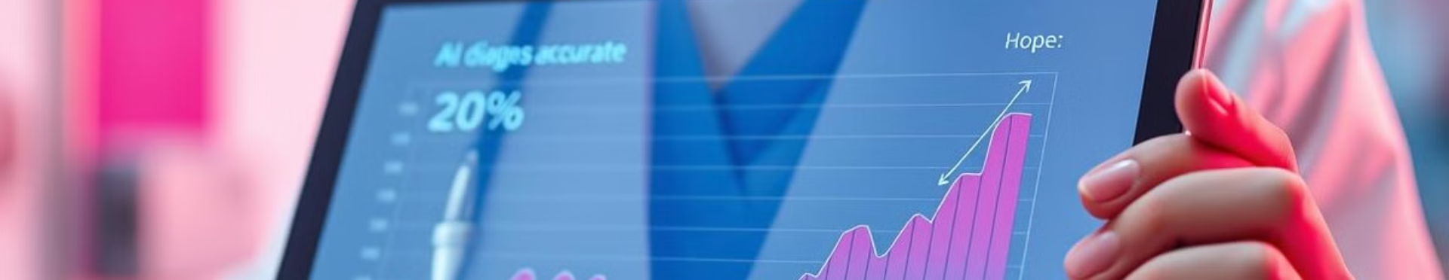
Conclusion: A Promising Future for AI in Healthcare
This AI-powered medical diagnosis system represents a significant leap forward in healthcare, offering faster, more accurate, and accessible diagnosis. The user-friendly Streamlit-based UI makes it easy for healthcare professionals to leverage the power of AI for improved patient care. This project serves as a strong foundation for future AI-driven healthcare innovations, leading to a more personalized and efficient healthcare ecosystem.

Slide 9
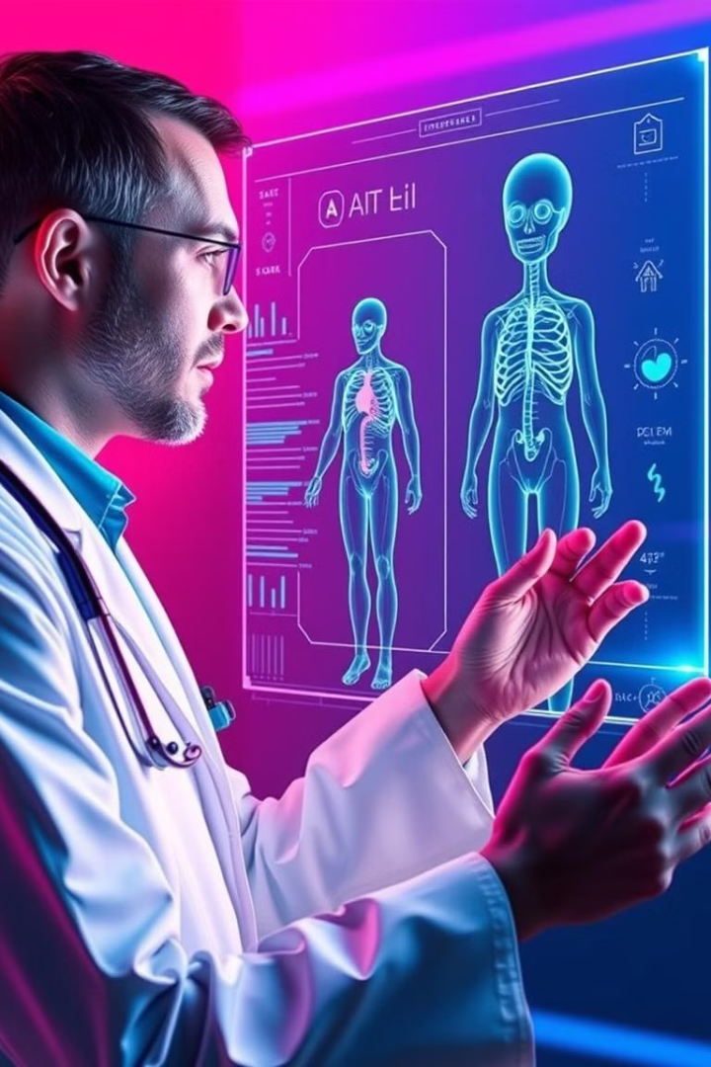
Key Takeaways: Redefining Medical Diagnosis
AI's Impact
AI-powered medical diagnosis significantly improves the speed and accuracy of disease prediction, revolutionizing the traditional diagnostic process.
Streamlit's Role
The Streamlit web application provides a user-friendly interface, enabling real-time disease prediction and enhancing accessibility for healthcare professionals.
Future Possibilities
The project lays the groundwork for future advancements in AI-driven healthcare, paving the way for personalized medicine, preventative care, and improved patient outcomes.

